Slide 1
XML Processing and Web Services
Chapter 17

Slide 2
Objectives
1
2
XML Overview
XML Processing
3
4
JSON
Overview of Web Services
5
6
Consuming Web Services in PHP
Creating Web Services
7
7
Asynchronous Web Services

Slide 3
XML Overview
Section 1 of 7

Slide 4
XML Overview
XML is a markup language, but unlike HTML, XML can be used to mark up any type of data.
One of the key benefits of XML data is that as plain text, it can be read and transferred between applications and different operating systems as well as being human-readable and understandable as well.
XML is not only used on the web server and to communicate asynchronously with the browser, but is also used as a data interchange format for moving information between systems

Slide 5
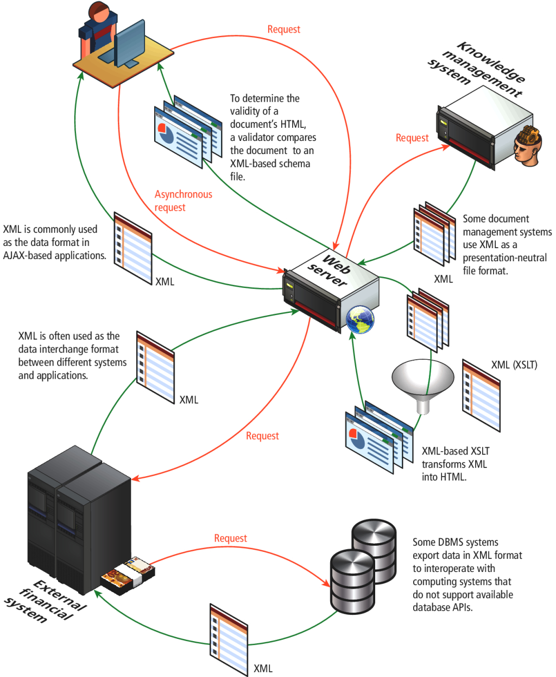
XML Overview
Used in many systems

Slide 6
Well Formed XML
For a document to be well-formed XML, it must follow the syntax rules for XML:
Element names are composed of any of the valid characters (most punctuation symbols and spaces are not allowed) in XML.
Element names can’t start with a number.
There must be a single-root element. A root element is one that contains all the other elements; for instance, in an HTML document, the root element is <html>.
All elements must have a closing element (or be self-closing).
Elements must be properly nested.
Elements can contain attributes.
Attribute values must always be within quotes.
Element and attribute names are case sensitive.

Slide 7
Valid XML
Requires a DTD
A valid XML document is one that is well formed and whose element and content conform to the rules of either its document type definition (DTD) or its schema.
A DTD tells the XML parser which elements and attributes to expect in the document as well as the order and nesting of those elements.
A DTD can be defined within an XML document or within an external file.

Slide 8
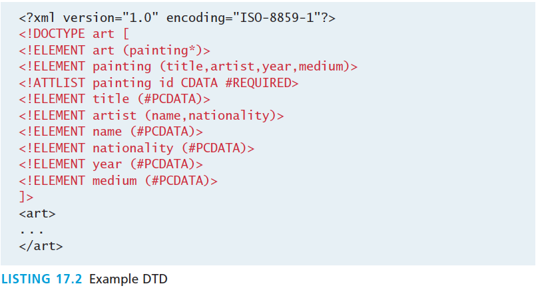
Data Type Definition
Example

Slide 9
Data Type Definition
Example
The main drawback with DTDs is that they can only validate the existence and ordering of elements. They provide no way to validate the values of attributes or the textual content of elements.
For this type of validation, one must instead use XML schemas, which have the added advantage of using XML syntax. Unfortunately, schemas have the corresponding disadvantage of being long-winded and harder for humans to read and comprehend; for this reason, they are typically created with tools.

Slide 10
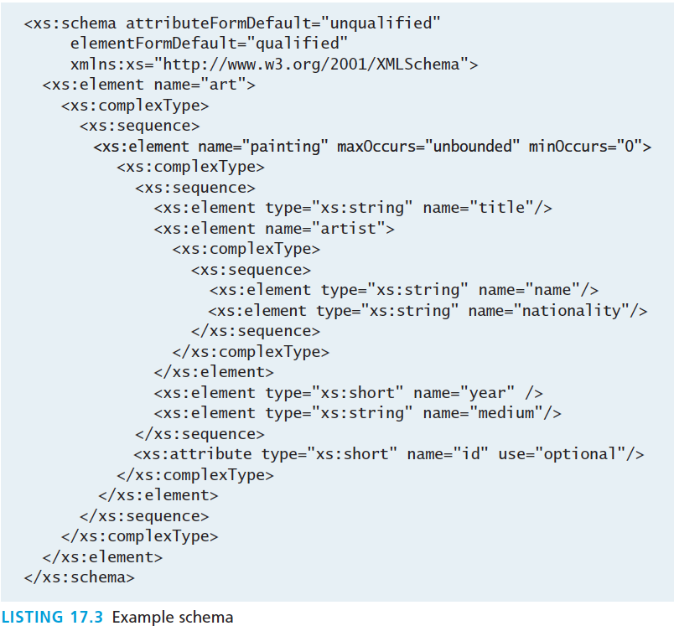
XML Schema
Just one example

Slide 11
XPath
Another XML Technology
XPath is a standardized syntax for searching an XML document and for navigating to elements within the XML document
XPath is typically used as part of the programmatic manipulation of an XML document in PHP and other languages
XPath uses a syntax that is similar to the one used in most operating systems to access directories.

Slide 12
XPath
Select each painting
Select artist name of painting with id=192
Select the id attribute of the third painting.
Learn by example
<?xml version="1.0" encoding="ISO-8859-1"?>
<art>
<painting id="290">
<title>Balcony</title>
<artist>
<name>Manet</name>
<nationality>France</nationality>
</artist>
<year>1868</year>
<medium>Oil on canvas</medium>
</painting>
<painting id="192">
<title>The Kiss</title>
<artist>
<name>Klimt</name>
<nationality>Austria</nationality>
</artist>
<year>1907</year>
<medium>Oil and gold on canvas</medium>
</painting>
<painting id="139">
<title>The Oath of the Horatii</title>
<artist>
<name>David</name>
<nationality>France</nationality>
</artist>
<year>1784</year>
<medium>Oil on canvas</medium>
</painting>
</art>

Slide 13
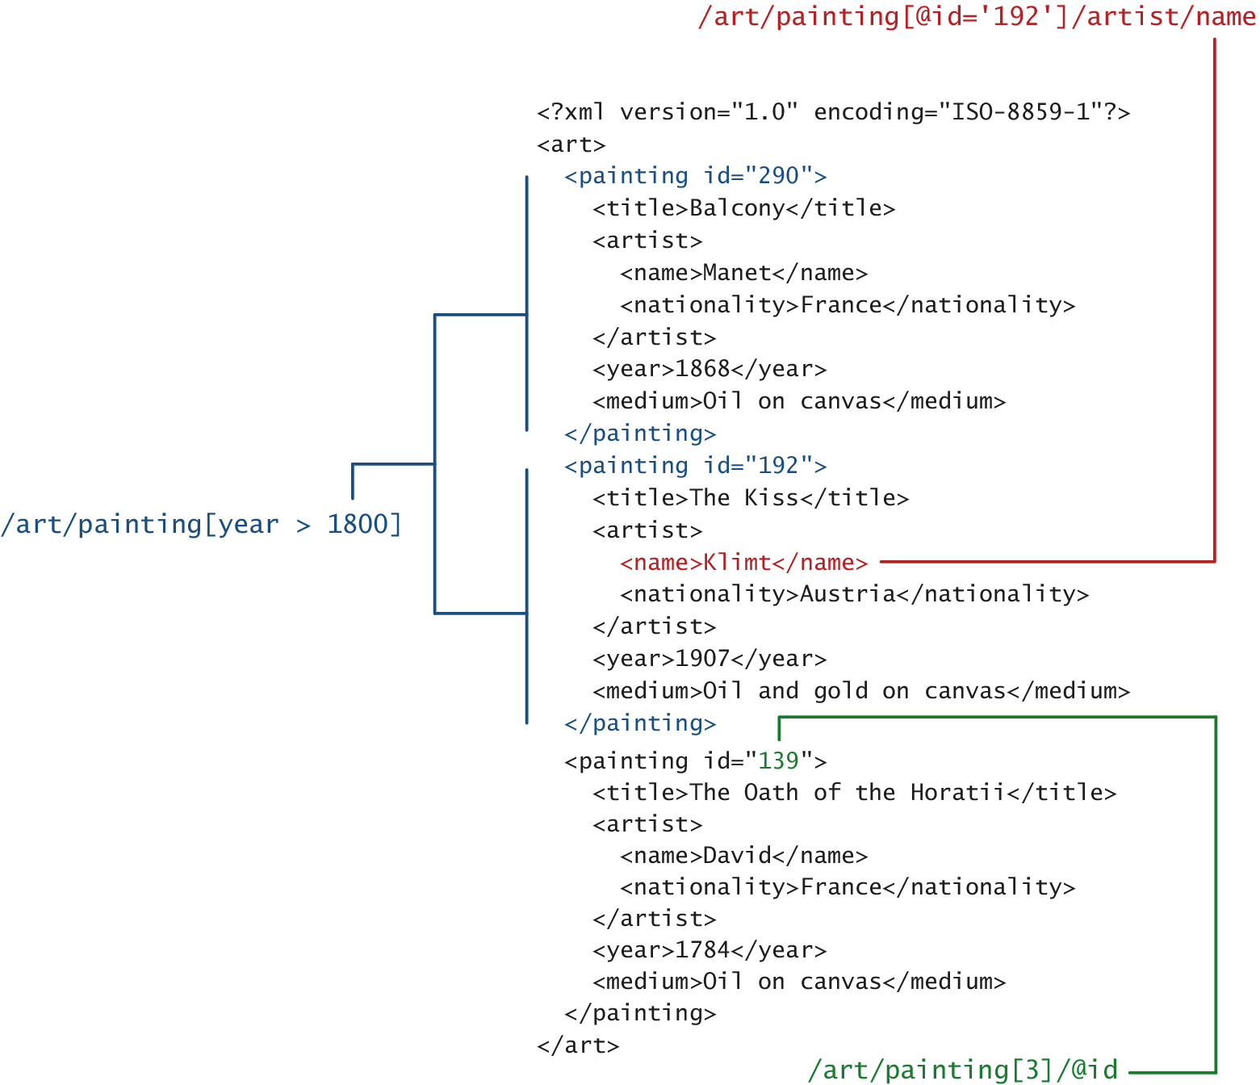
XPath
Learn through example

Slide 14
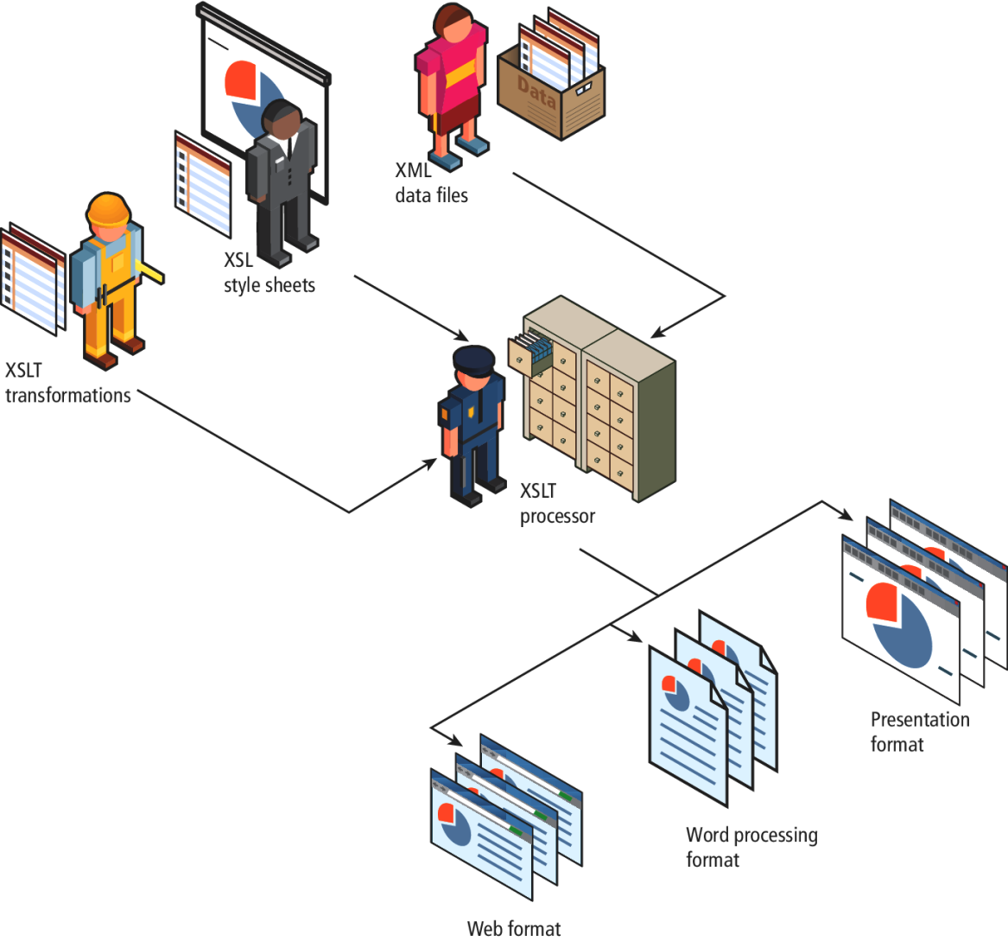
XSLT
XML Stylesheet Transformations
XSLT is an XML-based programming language that is used for transforming XML into other document formats

Slide 15
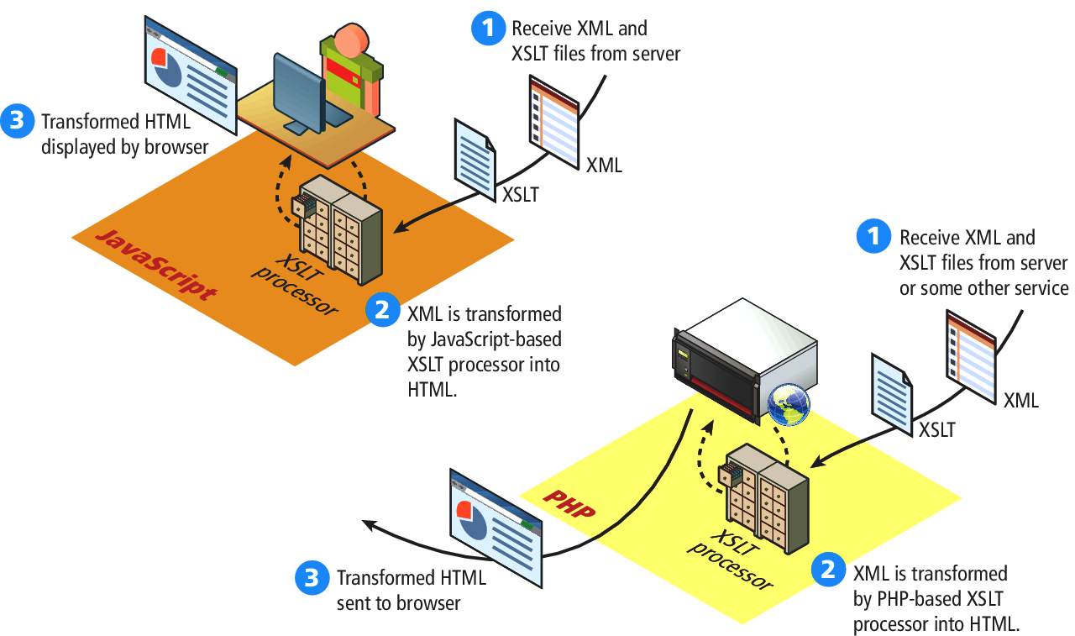
XSLT
Another usage
XSLT is also used on the server side and within JavaScript

Slide 16
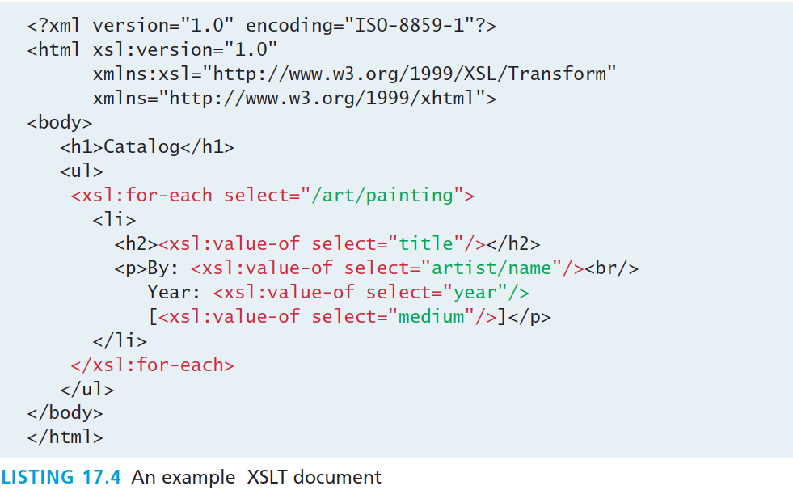
XSLT
Example XSLT document that converts the XML from Listing 17.1 into an HTML list

Slide 17
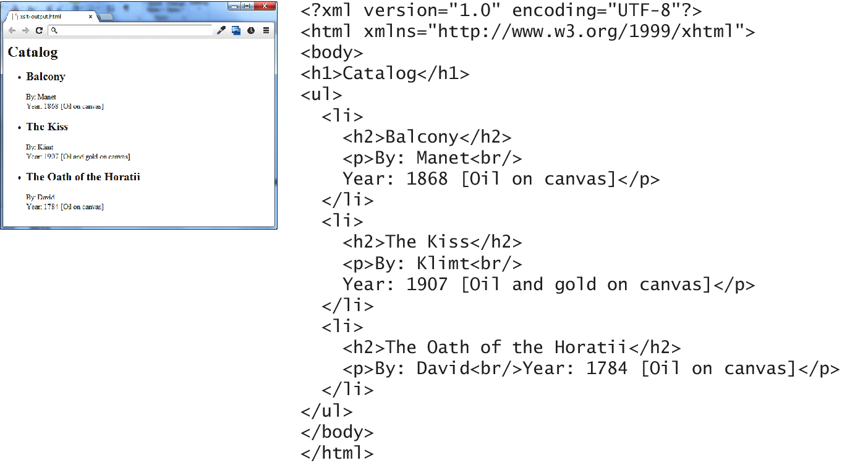
XSLT
An XML parser is still needed to perform the actual transformation

Slide 18
XML Processing
Section 2 of 7

Slide 19
XML Processing
Two types
XML processing in PHP, JavaScript, and other modern development environments is divided into two basic styles:
The in-memory approach, which involves reading the entire XML file into memory into some type of data structure with functions for accessing and manipulating the data.
The event or pull approach, which lets you pull in just a few elements or lines at a time, thereby avoiding the memory load of large XML files.

Slide 20
XML Processing
In JavaScript
All modern browsers have a built-in XML parser and their JavaScript implementations support an in-memory XML DOM API.
You can use the already familiar DOM functions such as getElementById(), getElementsByTagName(), and createElement() to access and manipulate the data.

Slide 21
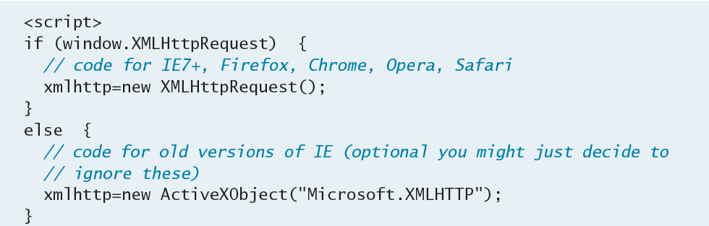
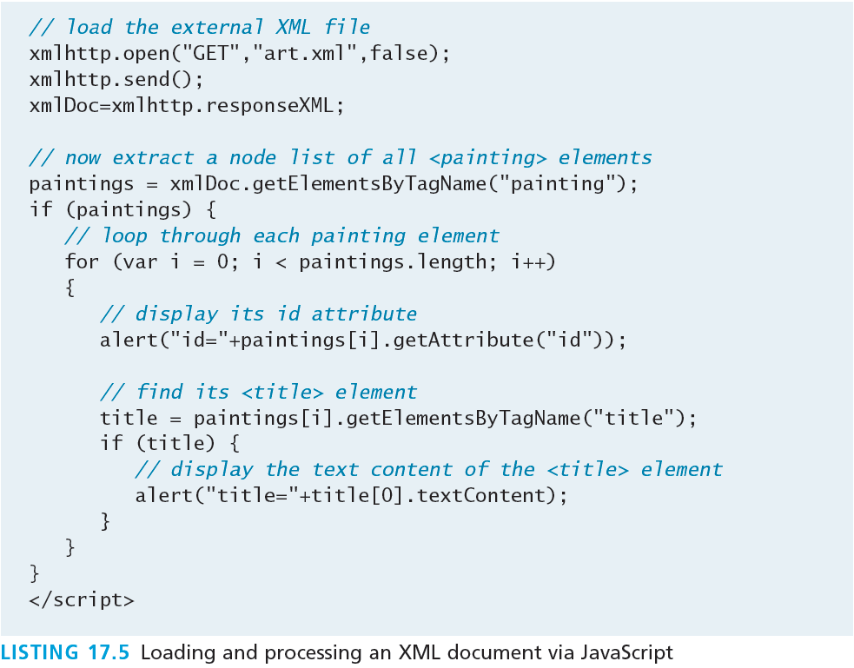
XML Processing

Slide 22
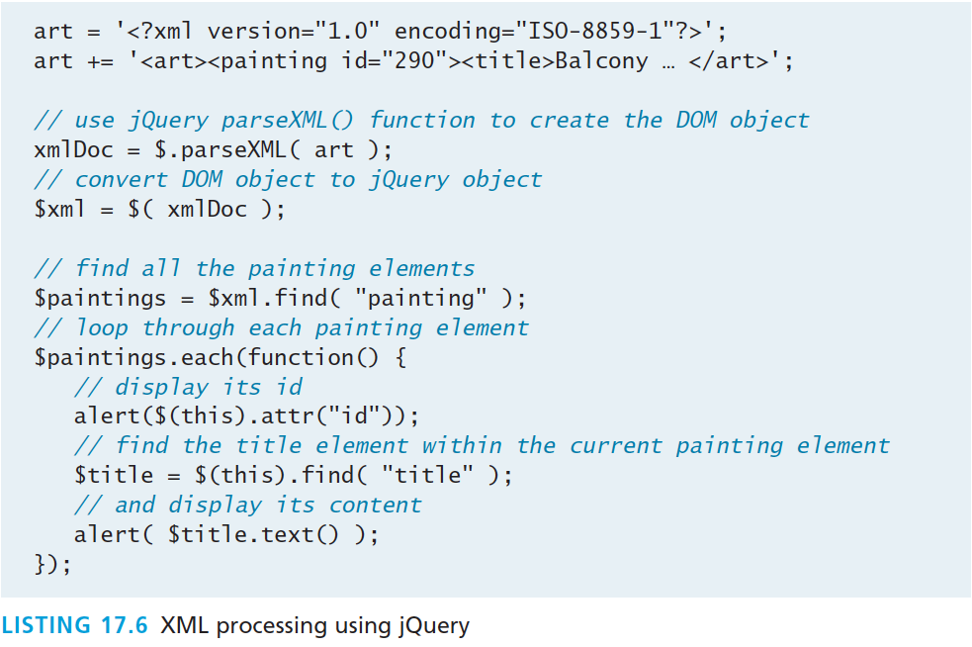
XML Processing
With JQuery

Slide 23
XML Processing
With PHP
PHP provides several extensions or APIs for working with XML including:
The SimpleXML extension which loads the data into an object that allows the developer to access the data via array properties and modifying the data via methods.
The XMLReader is a read-only pull-type extension that uses a cursor-like approach similar to that used with database processing

Slide 24
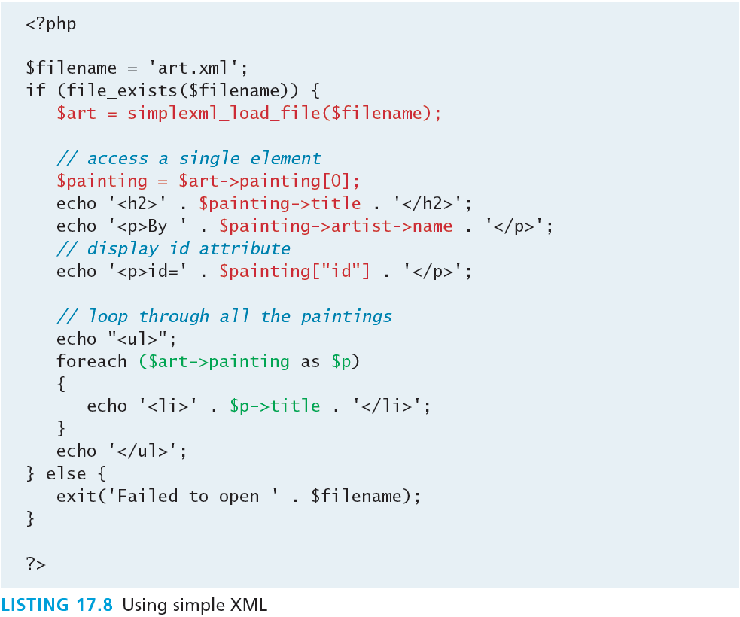
XML Processing
With PHP using Simple XML
Variable and attribute names taken from xml

Slide 25
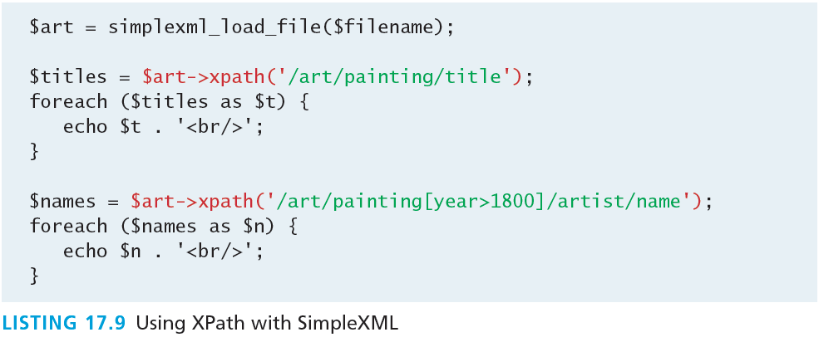
XML Processing
With PHP using Simple XML and XPath

Slide 26
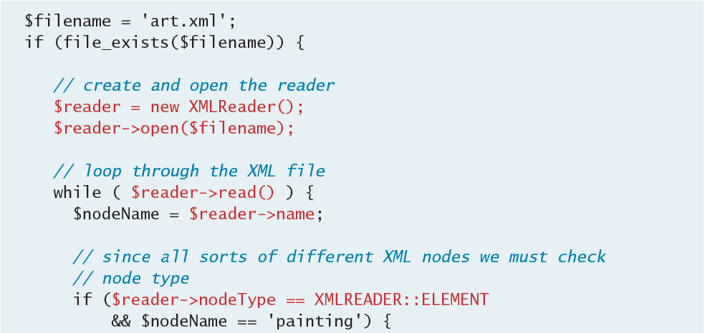
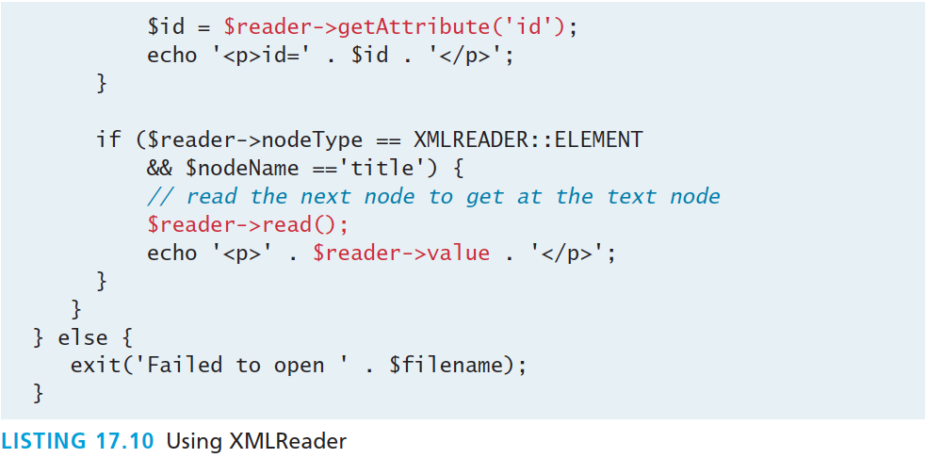
XML Processing
With PHP using XMLReader
Less “automatic”
More Verbose

Slide 27
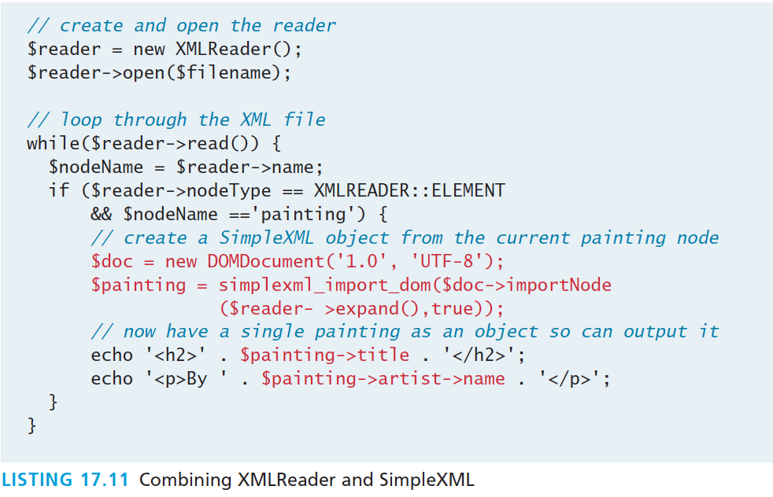
XML Processing
Why choose when you can use both

Slide 28
JSON
Section 3 of 7

Slide 29
JSON
JSON stands for JavaScript Object Notation (though its use is not limited to JavaScript)
Like XML, JSON is a data serialization format. It provides a more concise format than XML.
Many REST web services encode their returned data in the JSON data format instead of XML.

Slide 30
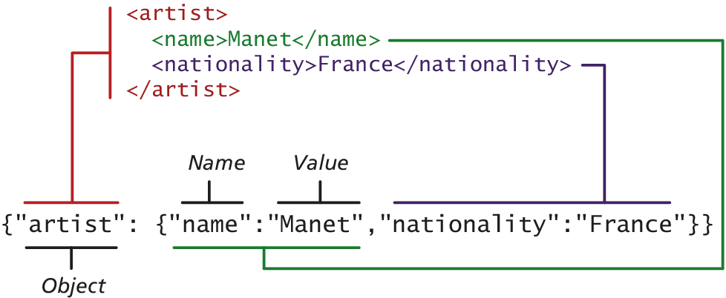
JSON
An example XML object in JSON

Slide 31
Using JSON in JavaScript
Creating JSON JavaScript objects
it is easy to make use of the JSON format in JavaScript:
var a = {"artist": {"name":"Manet","nationality":"France"}};
alert(a.artist.name + " " + a.artist.nationality);
When the JSON information will be contained within a string (say when downloading) the JSON.parse() function can be used to transform the string containing into a JavaScript object

Slide 32
Using JSON in JavaScript
Convert string to JSON object and vice versa
var text = '{"artist": {"name":"Manet","nationality":"France"}}';
var a = JSON.parse(text);
alert(a.artist.nationality);
JavaScript also provides a mechanism to translate a JavaScript object into a JSON string:
var text = JSON.stringify(artist);

Slide 33
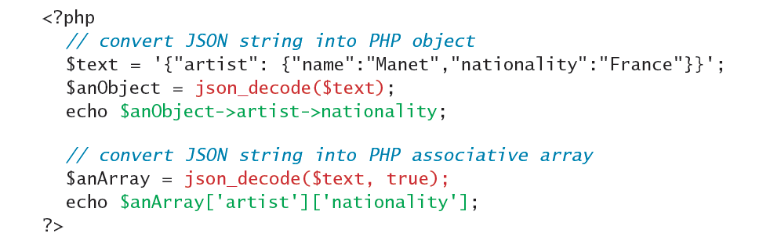
Using JSON in PHP
JSON on the server
Converting a JSON string into a PHP object is quite straightforward:
Notice that the json_decode() function can return either a PHP object or an associative array.

Slide 34

Using JSON in PHP
Go the other way
To go the other direction (i.e., to convert a PHP object into a JSON string), you can use the json_encode() function.

Slide 35
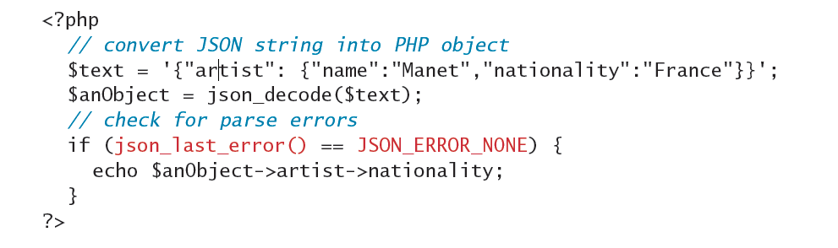
Using JSON in PHP
JSON on the server
Since JSON data is often coming from an external source, always check for parse errors before using it, via the json_last_error() function:

Slide 36
Overview of Web Services
Section 4 of 7

Slide 37
Web Services
An overview
Web services are the most common example of a computing paradigm commonly referred to as service-oriented computing (SOC).
A service is a piece of software with a platform-independent interface that can be dynamically located and invoked.
Web services are a relatively standardized mechanism by which one software application can connect to and communicate with another software application using web protocols.

Slide 38
Web Services
Benefits
they potentially provide interoperability between different software applications running on different platforms
they can be used to implement something called a service-oriented architecture (SOA)
they can be offered by different systems within an organization as well as by different organizations

Slide 39
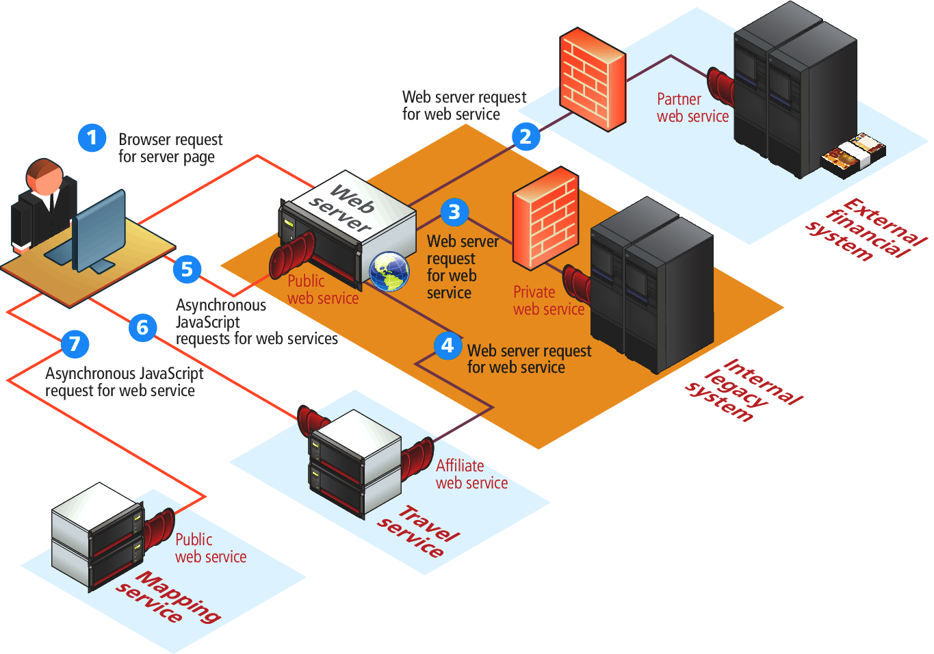
Web Services
Visual Overview

Slide 40
Web Services
SOAP Services
SOAP is the message protocol used to encode the service invocations and their return values via XML within the HTTP header.
SOAP and WSDL are complex XML schemas
akin to using a compiler: its output may be complicated to understand
the enthusiasm for SOAP-based web services had cooled.

Slide 41
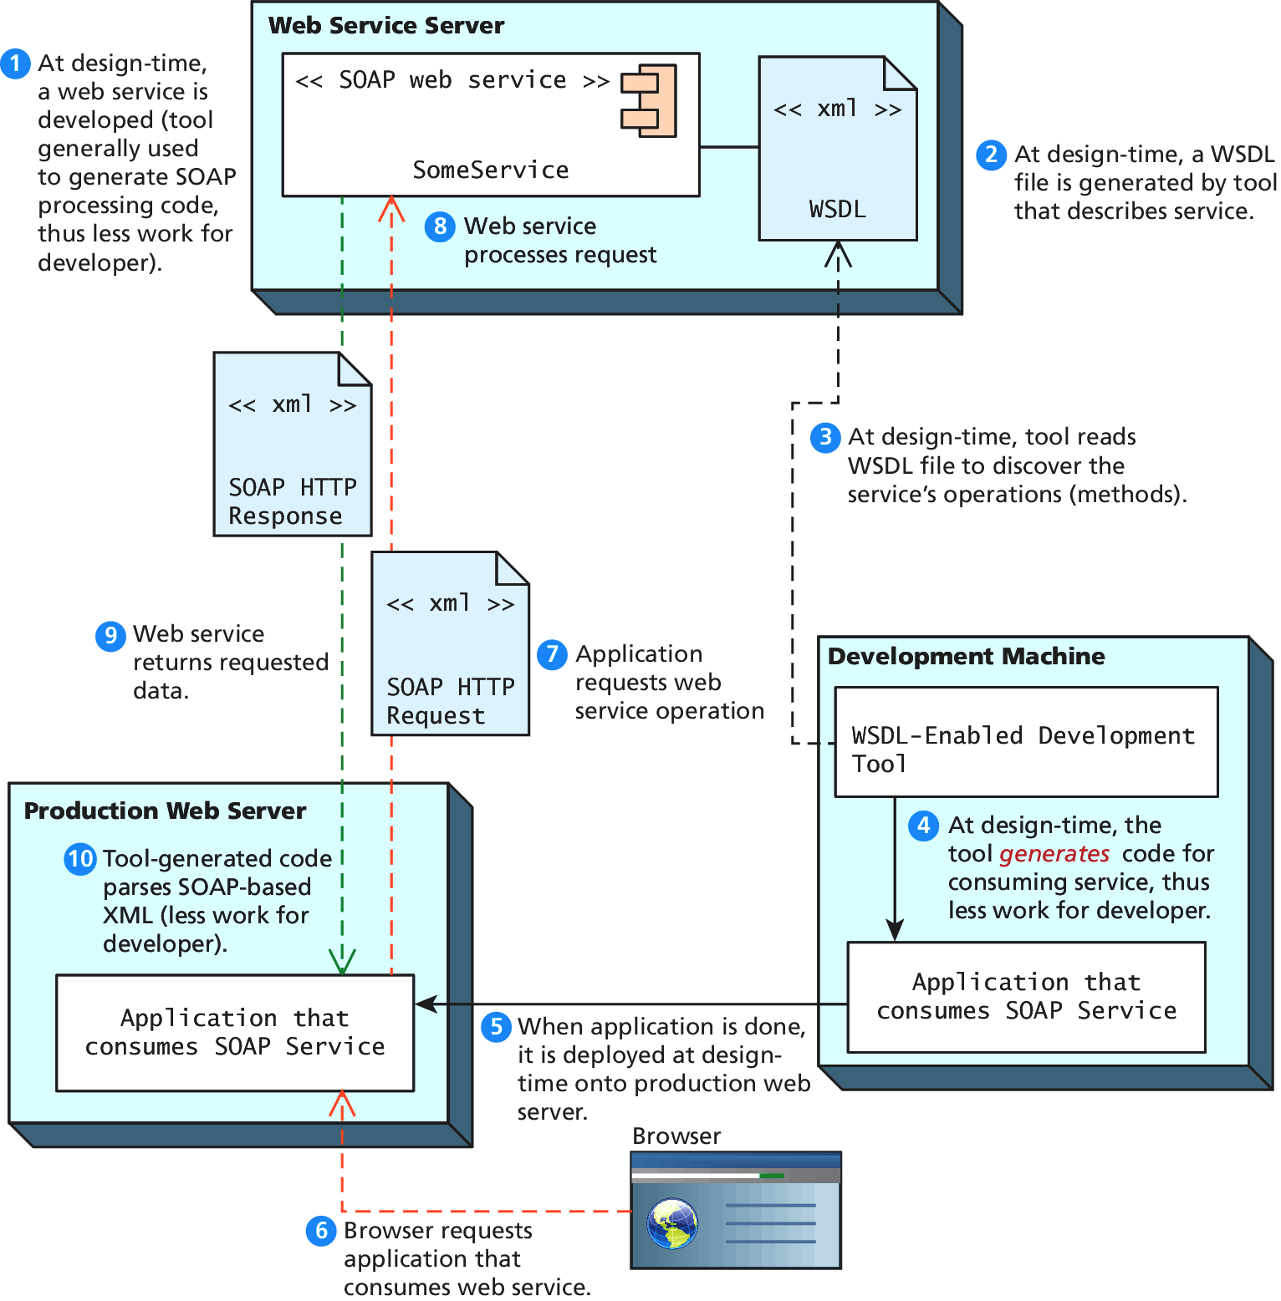
Web Services
SOAP Services

Slide 42
Web Services
REST Services
REST stands for Representational State Transfer.
RESTful web service does away with the service description layer, and needs no separate protocol for encoding message requests and responses.
It simply uses HTTP URLs for requesting a resource/object (and for encoding input parameters).
The serialized representation of this object, usually an XML or JSON stream, is then returned to the requestor as a normal HTTP response.
REST appears to have almost completely displaced SOAP services.

Slide 43
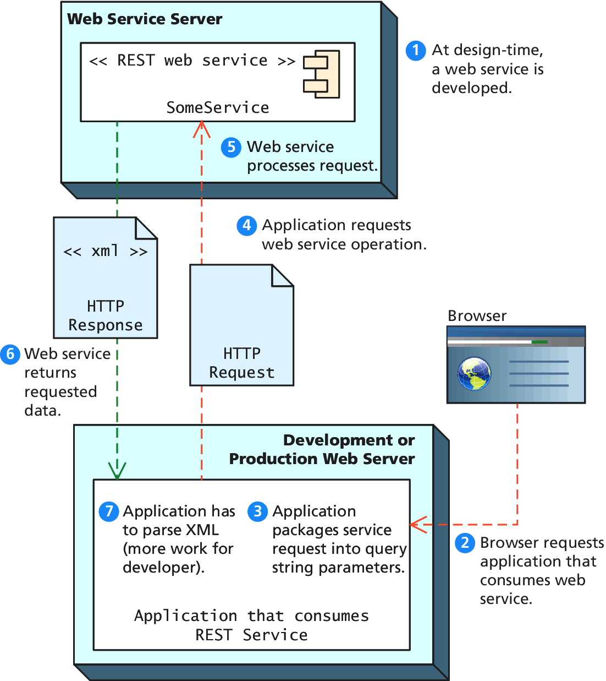
Web Services
REST Services

Slide 44
An Example Web Service
We will only use REST from here on in
Consider the Google Geocoding API.
The Google Geocoding API provides a way to perform geocoding operations via an HTTP GET request, and thus is an especially useful example of a RESTful web service.
Geocoding typically refers to the process of turning a real-world address into geographic coordinates, which are usually latitude and longitude values
Reverse geocoding is the process of converting geographic coordinates into a human-readable address.

Slide 45
An Example Web Service
Mashups abound with web services
From trendsmap.com

Slide 46
An Example Web Service
More details
In this case the request will take the following form:
http://maps.googleapis.com/maps/api/geocode/xml?address
An example geocode request would look like the following:
http://maps.googleapis.com/maps/api/geocode/xml?address=British%20Museum,+Great+Russell+Street,+London,+WC1B+3DG&sensor=false
From trendsmap.com

Slide 47
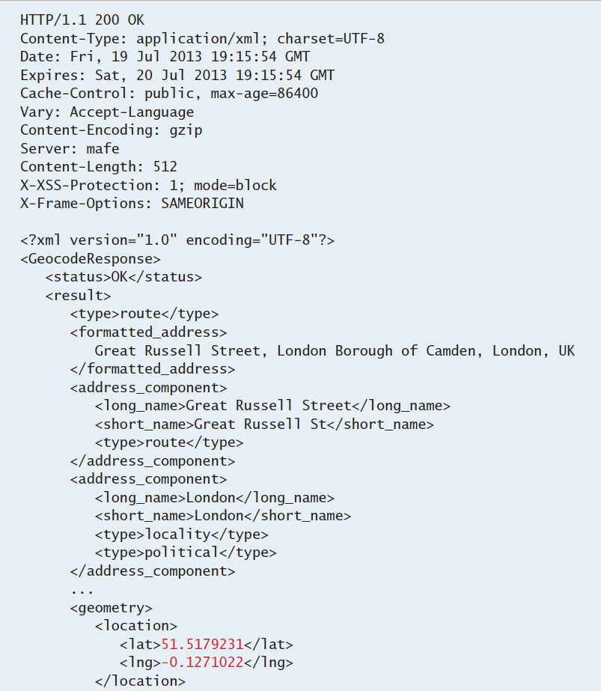
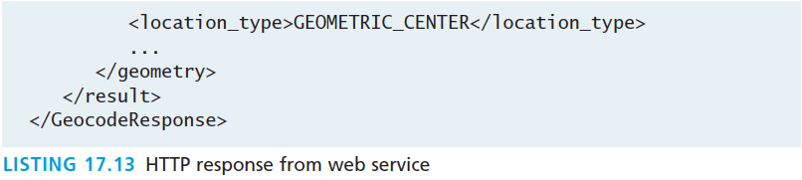
An Example Web Service
The Response
The response is a standard HTTP response with headers
This response is XML
The lat/lng is in there somewhere

Slide 48
Identifying and Authenticating Service Requests
Most web services are not open. Instead they typically employ one of the following techniques:
Identity. Each web service request must identify who is making the request.
Authentication. Each web service request must provide additional evidence that they are who they say they are.

Slide 49
Identity examples
Real World ways of limiting service
Web services that make use of an API key typically require the user (i.e., the developer) to register online with the service for an API key. This API key is then added to the GET request as a query string parameter.
For instance, to request to the Microsoft Bing Maps web service will look like the following :
http://dev.virtualearth.net/REST/v1/Locations?o=xml&query=British%20Museum,+Great+Russell+Street,+London,+WC1B+3DG,+UK&key=[BING API KEY HERE]

Slide 50
Identity examples
Real World ways of limiting service
Web services that make use of an API key typically require the user (i.e., the developer) to register online with the service for an API key. This API key is then added to the GET request as a query string parameter.
For instance, to request to the Microsoft Bing Maps web service will look like the following :
http://dev.virtualearth.net/REST/v1/Locations?o=xml&query=British%20Museum,+Great+Russell+Street,+London,+WC1B+3DG,+UK&key=[BING API KEY HERE]

Slide 51
Authentication
Real World ways of limiting service
Some web services are providing private/proprietary information or are involving financial transactions.
In this case, these services not only may require an API key, but they also require some type of user name and password in order to perform an authorization.
Many of the most well-known web services instead make use of the OAuth standard.

Slide 52
Consuming web Services in PHP
Section 5 of 7

Slide 53
Consuming Web Services in PHP
There are three usual approaches in PHP for making a REST request:
Using the file_get_contents() function.
Using functions contained within the curl library.
Using a custom library for the specific web service. Many of the most popular web services have free and proprietary PHP libraries available.

Slide 54
Consuming Web Services in PHP
The file_get_contents() function is simple but doesn’t allow POST requests
Services that require authentication will have to use the curl extension library, which allows significantly more control over requests. You may need to configure your server to include curl support.

Slide 55
A Flickr Example
The Flickr web service provides a photo search service. The basic format for this service method is:
http://api.flickr.com/services/rest/method=flickr.photos.search&api_key=[enter your flickr api key here]&tags=[search values here]&format=rest
The service will return its standard XML photo list

Slide 56
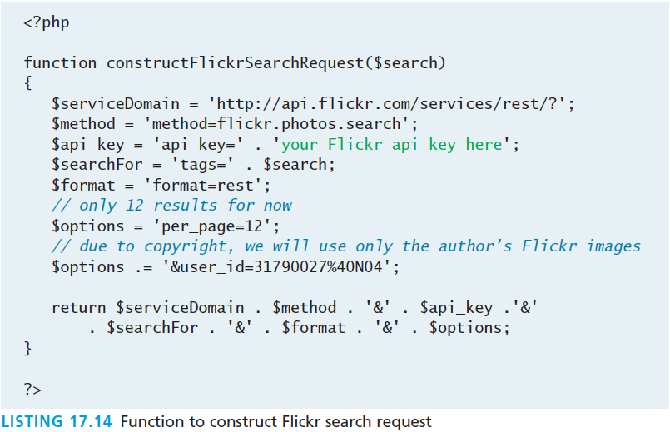
A Flickr Example
Some Code using file_get_contents()
$request = constructFlickrSearchRequest('Athens'); $response = file_get_contents($request);

Slide 57
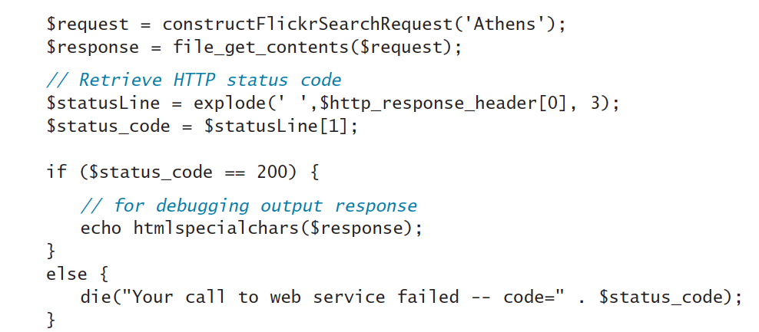
A Flickr Example
Use file get contents

Slide 58
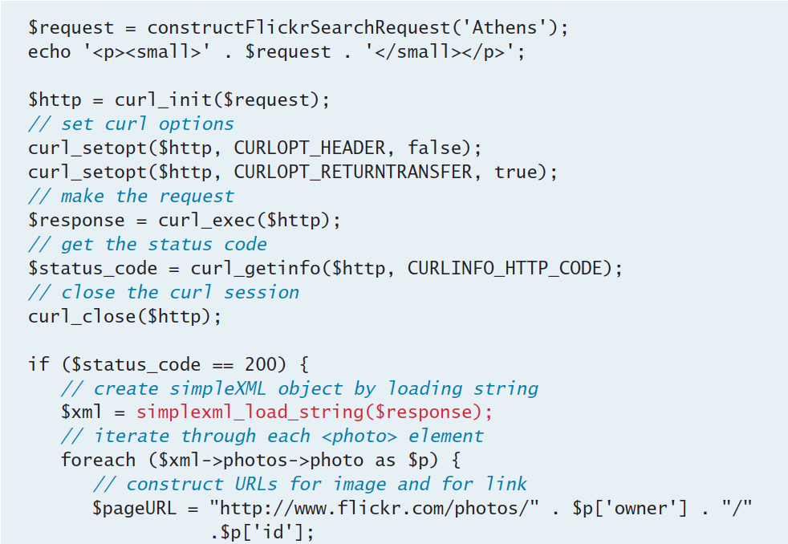
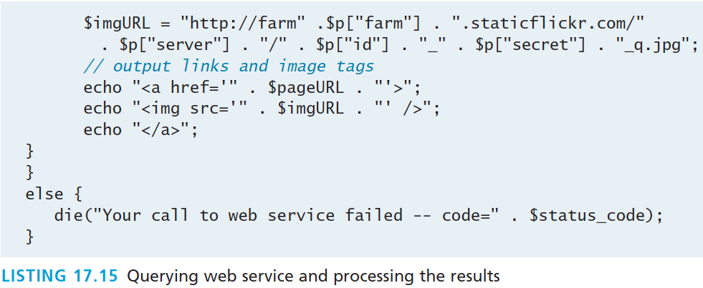
A Flickr Example
Use curl (and actually do something)
Make the request
Parse the XML

Slide 59
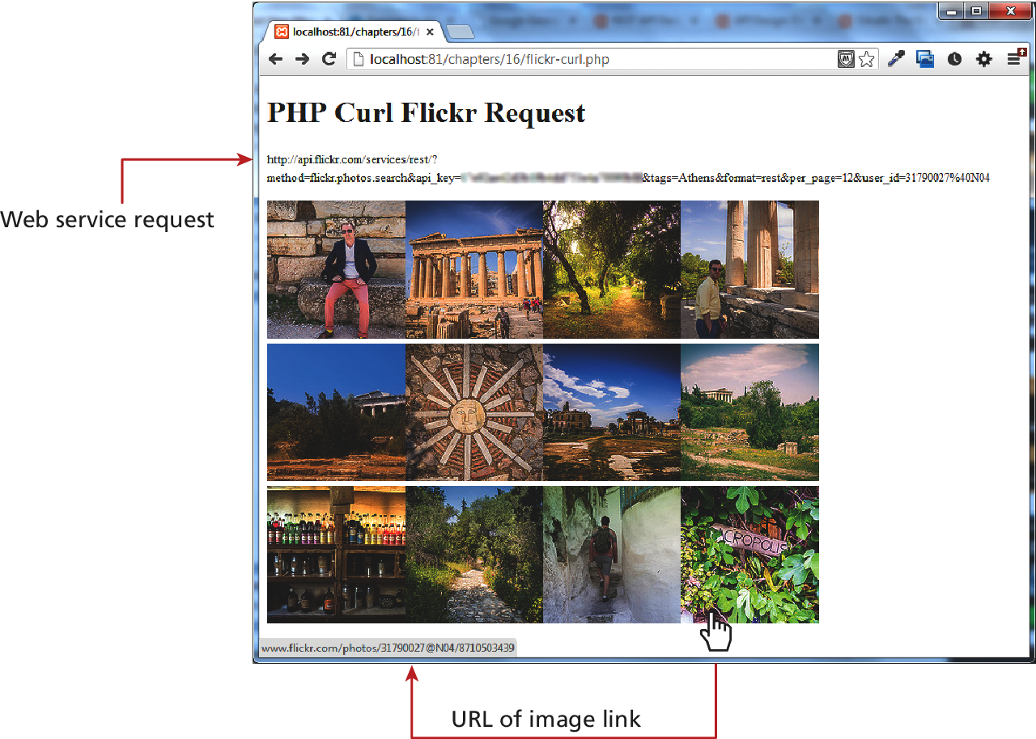
A Flickr Example
What that last code actually built

Slide 60
Consuming JSON Services
Consuming a JSON web service requires almost the same type of PHP coding as consuming an XML web service.
But rather than using SimpleXML to extract the information one needs, one instead uses the json_decode() function.

Slide 61
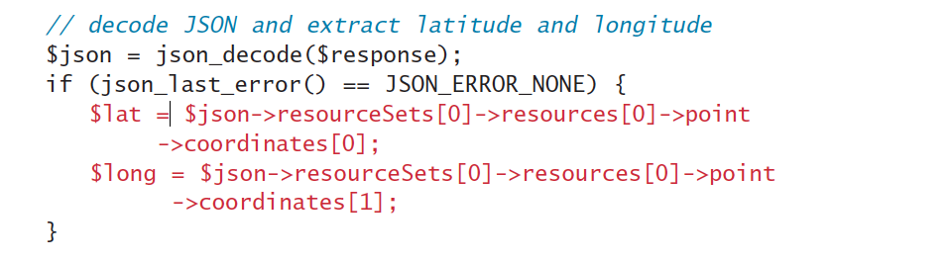
Consuming JSON Services
Combine 2 services (using JSON)
To extract the latitude and longitude from the JSON string returned from the mapping web service, you would need code similar to the following:
Once our program has retrieved the latitude and longitude, the program then will use the GeoNames web service’s. This request will take the following form:
http://api.geonames.org/findNearbyPOIsOSMJSON?lat=43.6520004&lng=-79.4082336&username=your-username-here

Slide 62
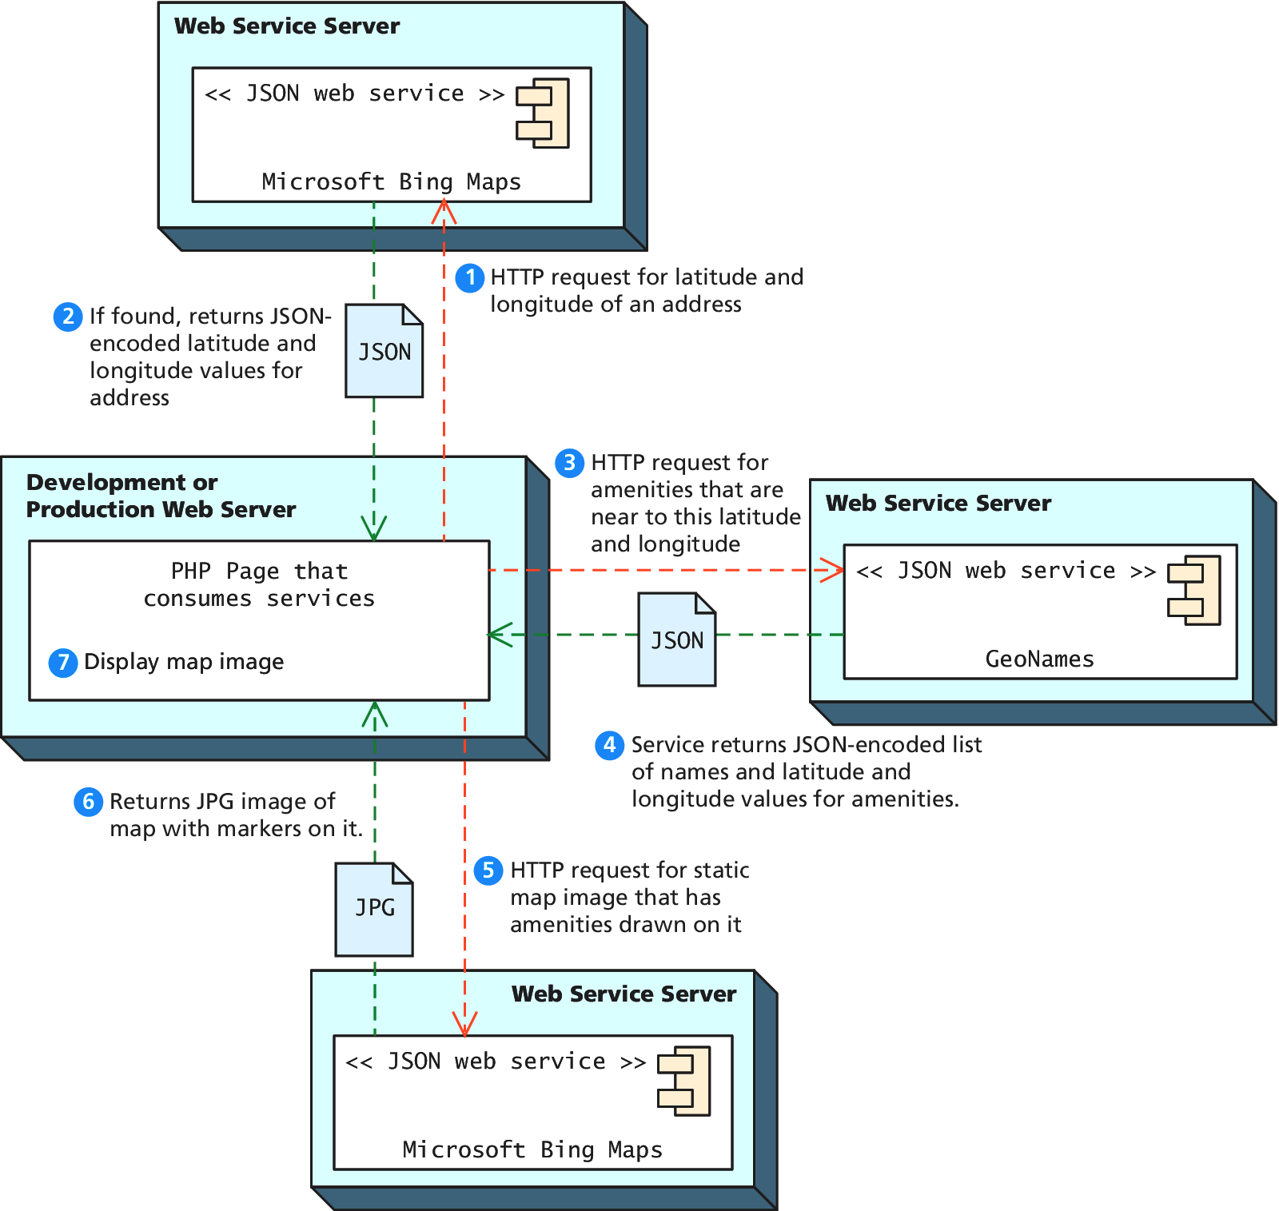
Consuming JSON Services
A complicated example with 2 services

Slide 63
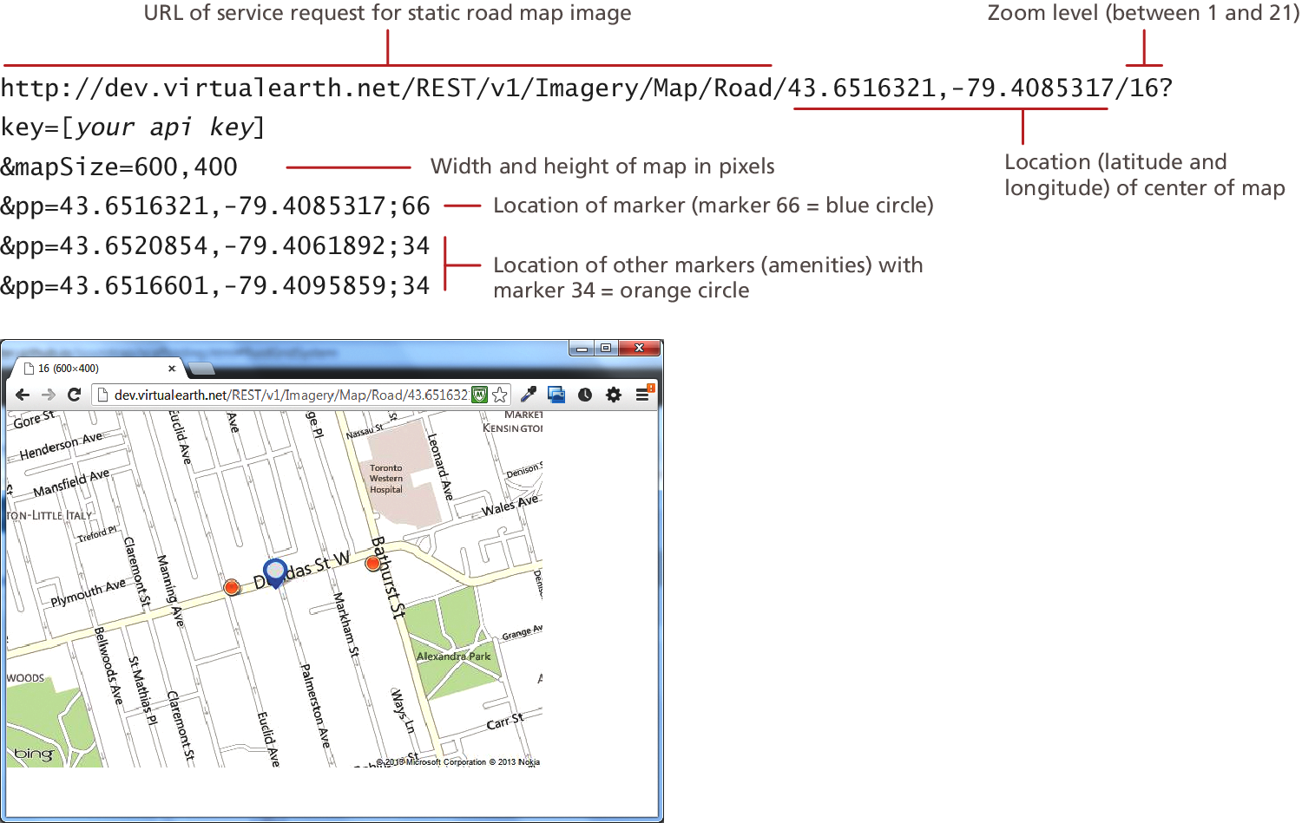
Consuming JSON Services
More examples

Slide 64
Consuming JSON Services
More examples

Slide 65
Creating Web Services
Section 6 of 7

Slide 66
Creating Your Own Services
Web Services that is
Since REST services simply respond to HTTP requests, creating a PHP web service is only a matter of creating a page that responds to query string parameters and instead of returning HTML, it returns XML or JSON.
Our PHP page must also modify the Content-type header
Is important to recognize that not all web services are intended to be used by external clients. Many web services are intended to be consumed asynchronously by their own web pages via JavaScript

Slide 67
Creating an XML Service
Web Service, that is
The first service we will create will be one that returns data from our Book Customer Relations Management database.
To begin, we should determine the methods our service will support and the format of the requests.
crmServiceSearchBooks.php?criteria=yyy&look=zzz
The criteria parameter will be used to specify what type of criteria we will use for the book search. This exercise will only support four values: imprint, category, look, and subcategory.
The look parameter will be used to specify the actual value to search.

Slide 68
Creating an XML Service
Web Service, that is
For instance, if we had the following request:
crmServiceSearchBooks.php?criteria=subcategory&look=finance
It would be equivalent to the SQL search:
SELECT * FROM Books WHERE SubCategoryID=5

Slide 69
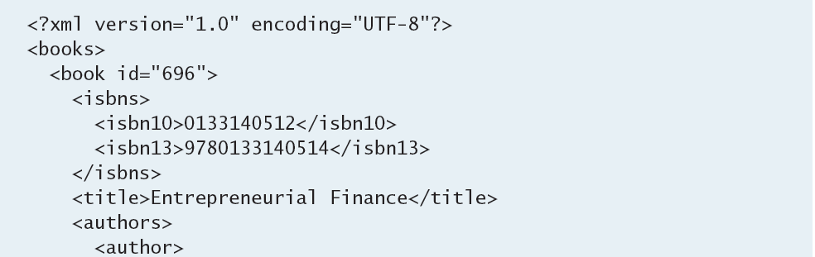
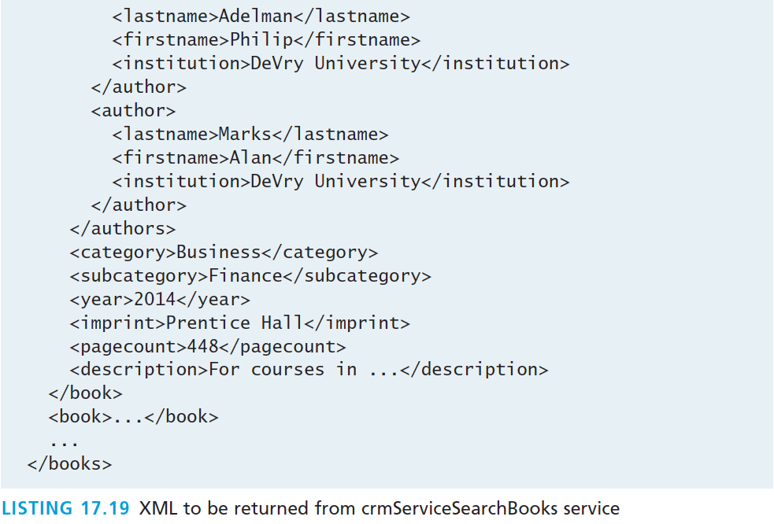
Creating an XML Service
Sample XML output

Slide 70
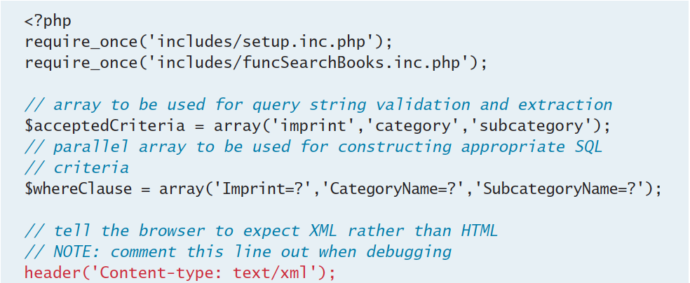
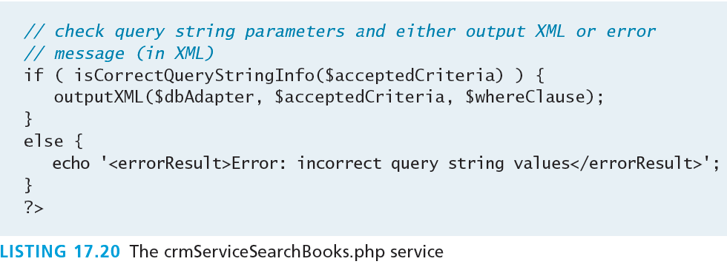
Creating an XML Service
Sample XML output

Slide 71
Creating an XML Service
Code details left as an exercise
There are different ways to output XML in PHP. One approach would be to simply echo XML within string literals to the response stream:
echo '<?xml version="1.0" encoding="UTF-8"?>’; echo '<books>';
. . .
While this approach has the merit of familiarity, it will be up to the programmer to ensure that our page outputs well-formed and valid XML.
The alternate approach would be to use one of PHP’s XML extensions such as the XMLWriter object.

Slide 72
Creating an JSON Service
Web Service
Creating a JSON web service rather than an XML service is simply a matter of
creating a JSON representation of an object
setting the Content-type header to indicate the content will be JSON,
and then outputting the JSON object
Since the built-in PHP json_encode() function does most of the work for us, our JSON service is simpler than the XML web service from the last section

Slide 73
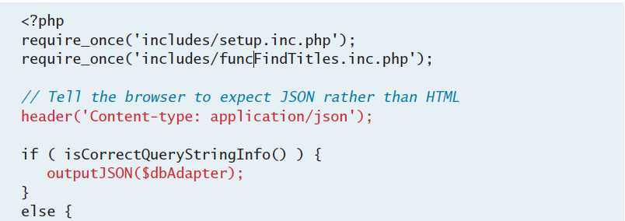
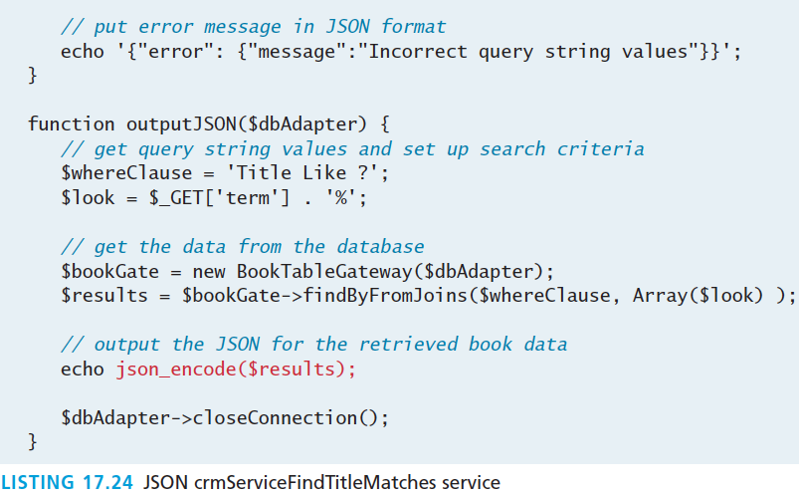
Creating an JSON Service
Web Service
Output headers
Function to create JSON
From the Database, based on query

Slide 74
Creating an JSON Service
Web Service
For this function to work, the class of the custom object being converted must provide its own implementation of the JsonSerializable interface. T
his interface contains only the single method jsonSerialize().
In this web service, we are outputting JSON for objects of the Book class, so this class will need to implement this method

Slide 75
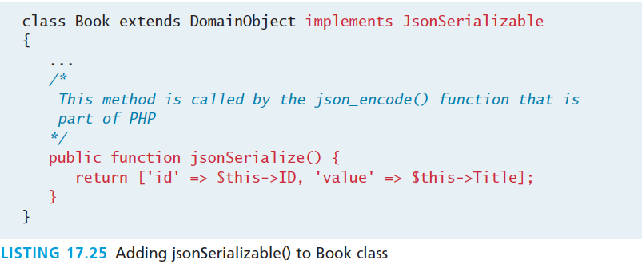
Creating an JSON Service
Web Service

Slide 76
Creating an JSON Service
Testing our service in the browser

Slide 77
Interacting Asynchronously with Web Services
Section 7 of 7

Slide 78
Tying it all together
Consuming services asynchronously
Although it’s possible to consume web services in PHP, it’s far more common to consume those services asynchronously using JavaScript.
When using client-side requests for third-party services, there’s also the advantage of distributing requests to each client rather then making all requests from your own server’s IP address.

Slide 79
Consuming your own service
Autocomplete example

Slide 80
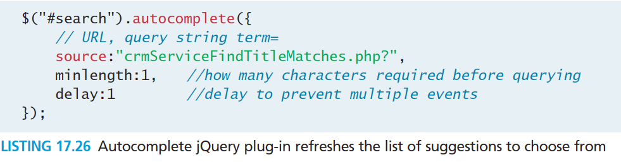
Consuming your own service
Autocomplete example
The code listens for changes to an input box with id search. With each change the code makes an asynchronous get request to the source URL, which in this case is the script in Listing 17.24 that returns JSON results. Those results are then used by autocomplete to display nicely underneath the input box.

Slide 81
Using Google Maps
A popular mashup platform
Consider our photo-sharing website. We will show you how to build a map view that plots user photos onto a map using the location information associated with the image.
To begin using Google Maps, you must do three things
Include the Google Maps libraries in the <head> section of your page.
Define <div> elements that will contain the maps.
Initialize instances of google.maps.Map (we will call it Map) in JavaScript and associate them with the <div> elements.

Slide 82
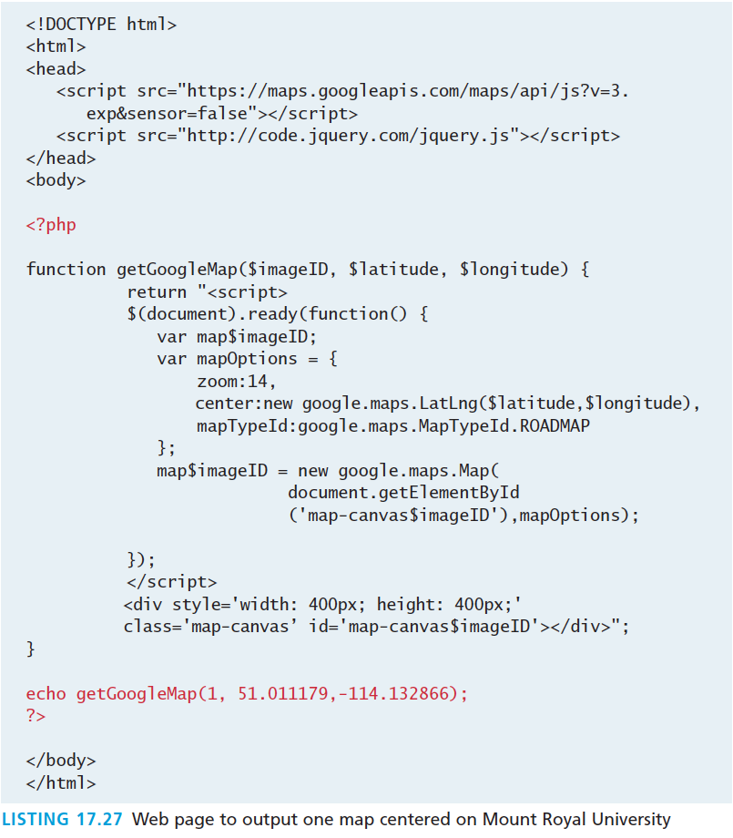
Using Google Maps
A popular mashup platform

Slide 83
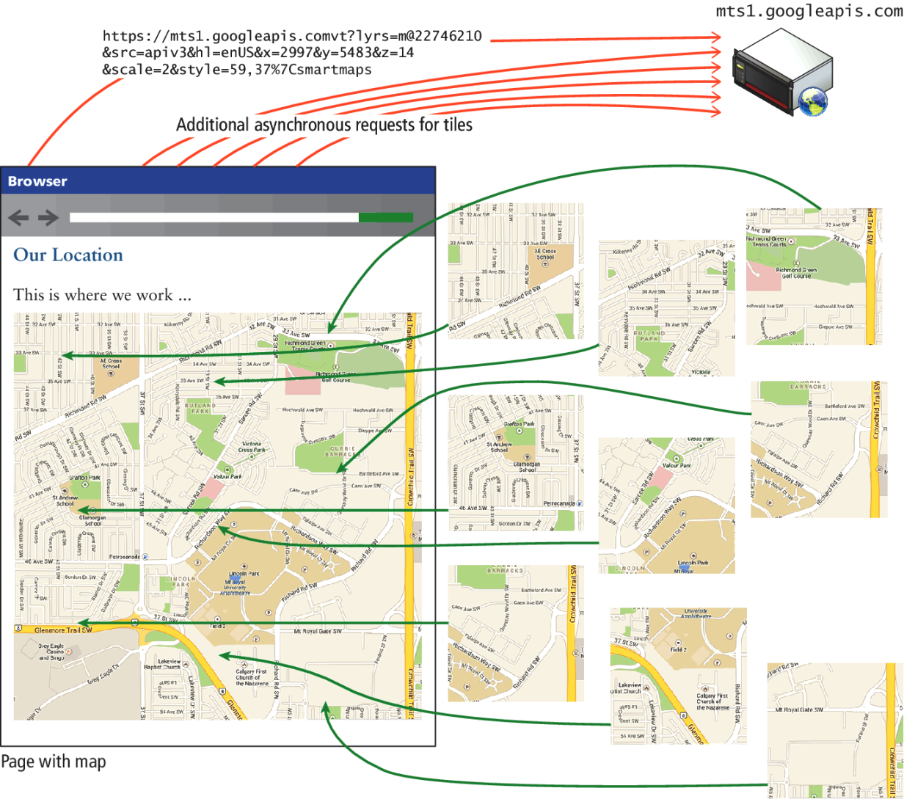
Using Google Maps
Under the hood there are lots of asynchronous requests

Slide 84
Using Google Maps
A sample mashup

Slide 85
What You’ve Learned
1
2
XML Overview
XML Processing
3
4
JSON
Overview of Web Services
5
6
Consuming Web Services in PHP
Creating Web Services
7
7
Asynchronous Web Services

